Slide 1

Welcome to Nursery
2026

Slide 2
Aims of the Meeting
Curriculum
Structure of the day
Key person
Learning journals
Parents’ role
Bags for home
Transition day
Questions

Slide 3
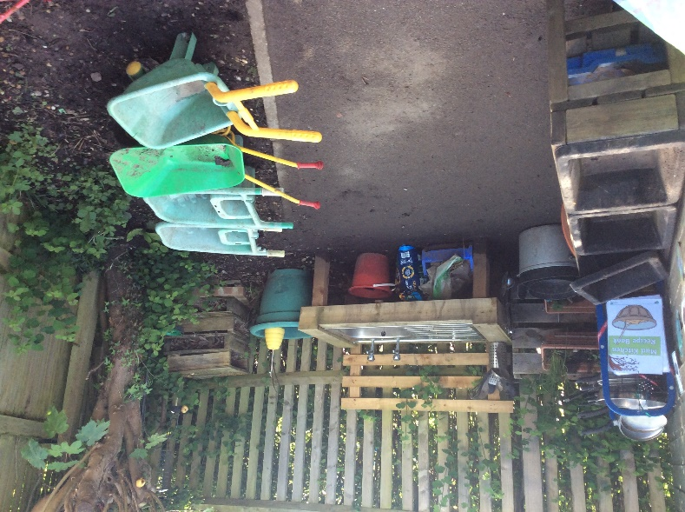
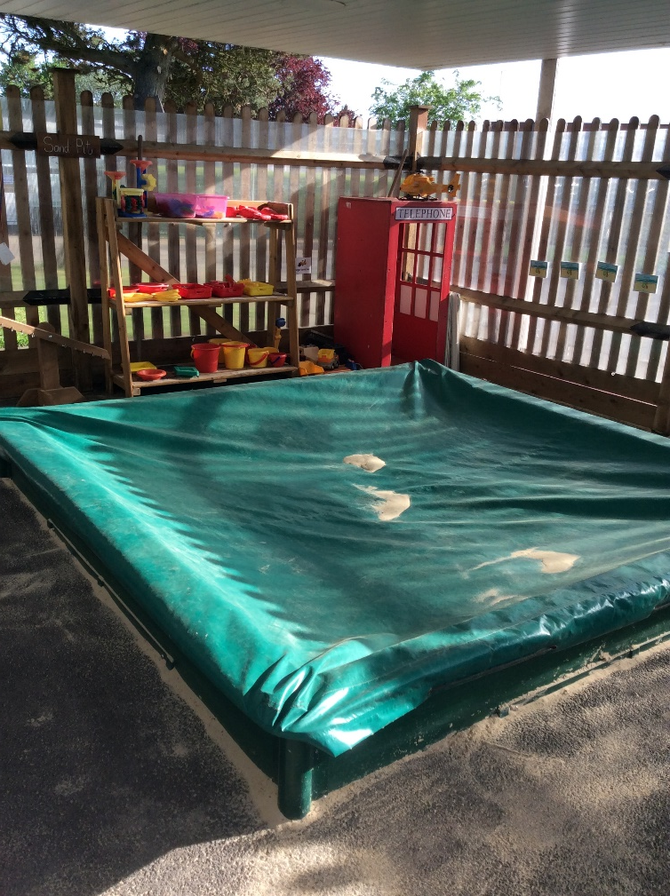
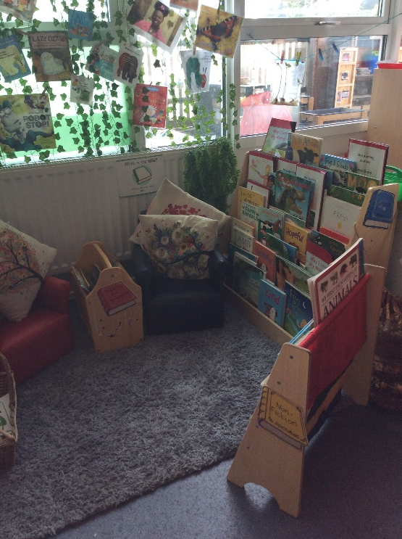
Acorn Nursery

Slide 4
Transition
We will have home visits/setting visits/ transition day.
Each child is different, and some may take a little longer to settle.
Our transition processes are based on the best interests and needs of your child.
We will work with you to help your child to settle and be confident in their new surroundings.

Slide 5
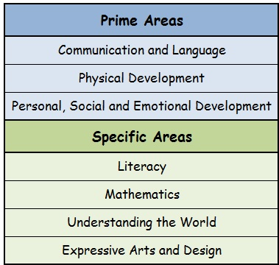

Curriculum
(EYFS)
Adopter

Slide 6
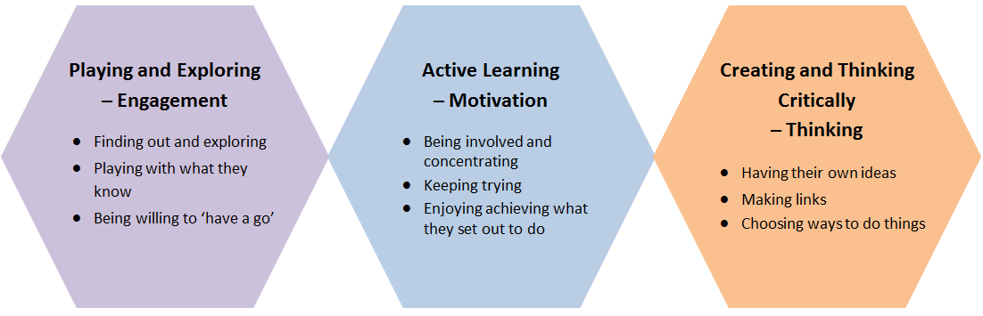
Characteristics of Learning

Slide 7
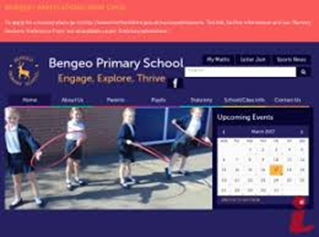
All our areas of learning are part of the Early Years Foundation Stage Curriculum and are planned by the class teachers. The curriculum overview details the topics covered over the year and is on the school website.
More detailed information about year group expectations can be found on the website: Statutory - Curriculum.

Slide 8



Diverse Curriculum
We are committed to providing a curriculum for every child, reflecting the rich culture in which we live.
We aim to celebrate the contribution of all people.
We will continue to evaluate and adapt our curriculum to ensure that it is diverse and inclusive.

Slide 9

Finger Strong
Self Registration
Adult-Led Learning – topic related
Small group time
Explore and Learning, Child-Initiated learning
Adult-led Learning - maths
Singing
Lunch Time for children staying all day

Slide 10

PE
Phonics
Small group time
Explore and Learning
PSHE/discussion
Story
Home time

Slide 11
Key Person…….
Is a named person who has responsibilities for a small group of children. They are there to help the child feel safe and secure. They will respond to children’s needs and development.
They will be a point of contact for parents.

Slide 12


Learning Journey
Online – Evidence Me
Track progress via observation and photographs
2 way process where parents can submit observations
Shared half termly on Evidence Me
Information to follow

Slide 13
Communication
The teacher will be at the gate welcoming the children every morning. Please feel free to pass on brief messages or ask questions.
You can also email the office via admin@bengeo.herts.sch.uk and we will get back to you as soon as possible.
Please inform the class teacher verbally or via the admin email above if there are any pick-up changes.
Google Classroom will be used for any additional communication from teachers. It is important that you check it regularly.

Slide 14

Keeping Children Safe

Slide 16
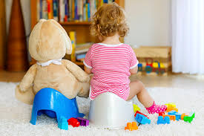
Toilet Training
We expect most children to be dry by the time they start Nursery in September.
If your child is in nappies now, we expect most children will have started toilet training.
If there are any reasons why your child cannot start toilet training, please speak to the Class Teacher.
We understand that there are going to be accidents.
It's important to note that the Summer holidays are an ideal time to start toilet training.

Slide 17

Toilet Training Tips
Let your child learn how to pull their clothes up and down.
Leave a potty visible.
Take your child to the toilet regularly. Try every hour.
Allow them to choose their own pants or knickers.

Slide 18
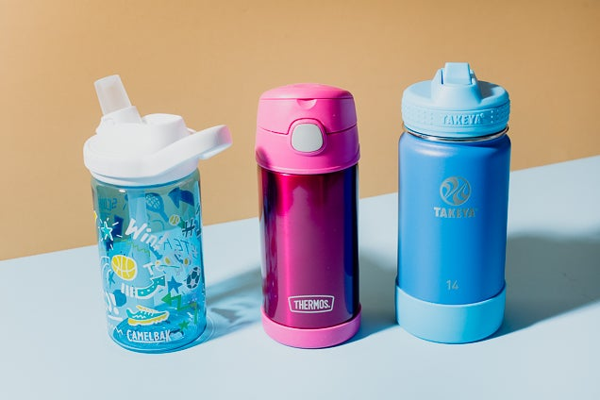


Top Tips
Bags to nursery – Draw string bags for changes of clothes and spare shoes
Coats with loops to hang on hooks – be independent
String on gloves – so you will always have a pair
Don’t expect your child to always come home ‘clean’
Try to encourage them to put on their own coats and shoes. Be independent.
Bring a water bottle every day
Please name everything

Slide 19


Key Dates
Thursday 9th July 2026 – Transition 9.30-10.15 Morning – Stay and Play TIME
ONLY for children who do not attend Bengeo Playgroup.
Wednesday 2nd September
Meet your child’s Key Person and explore the Nursery.
Times to be confirmed in due course.
45-minute time slot on your letters.

Slide 20


Slide 21


