Slide 1
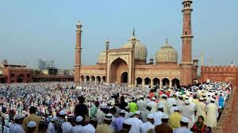
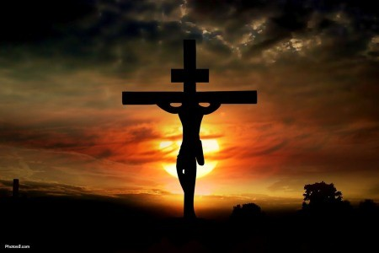
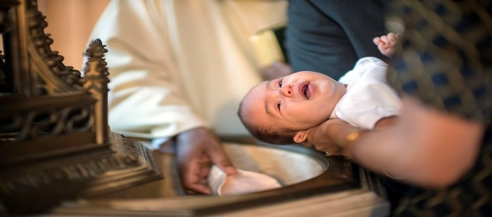
1 Marking festivals, traditions and key events in life
Sticky Knowledge
Look at two contrasting religions- Christianity and Islam.
Describe ways and traditions of celebrating festivals (e.g. Eid-ul-Adha, Eid Al Fitr, Easter, Christmas).
Describe how important events in life (birth welcoming ceremonies and traditions, e.g. Christian Baptism and Muslim Shahada) are celebrated.
Explore different ways of marking the same event (e.g. Christmas, ceremonies of belonging).
Assessment:
If you went on a pilgrimage, how do you think you would feel?
How do Muslims and Christians show they belong to a community?
Can you name a Christian and Muslim festival?
What is it like to follow God?
Key Words
Baptism, font, ceremony, Vicar, Godparents
Easter, Jesus, crucified, cross, Judas, disciples, resurrection
Christmas, Jesus, Nativity, worship, birth, Mary, Joseph Bethlehem, angel
Eid- Ul- Adha, sacrifice, pilgrimage, Hajj, Abraham
Eid –Al- Fitr, Fast, Ramadan, Prophet Muhammad, Allah, prayer

Slide 2
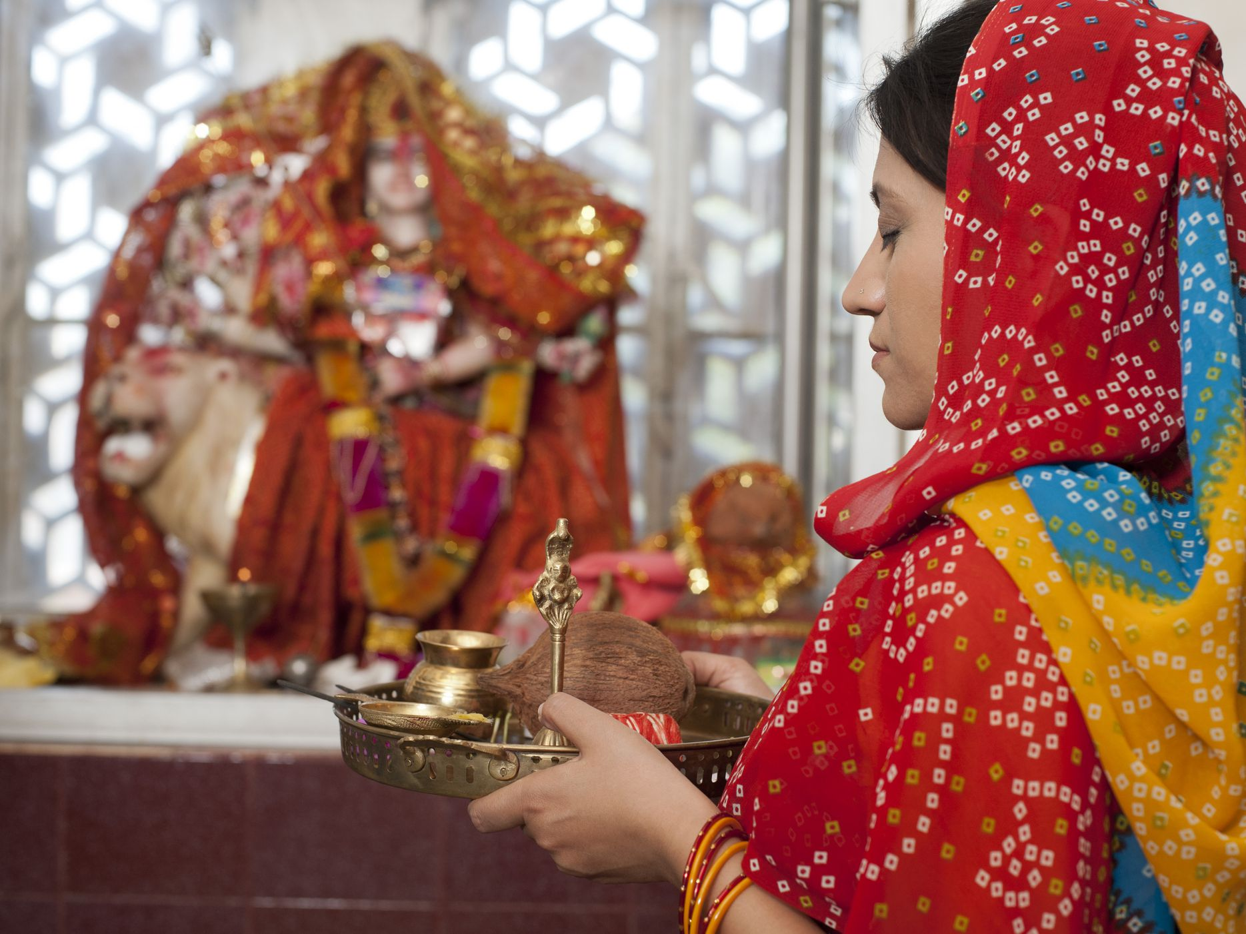
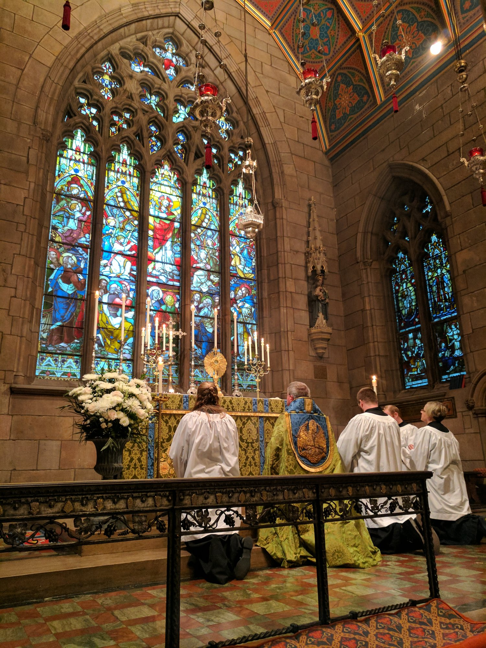
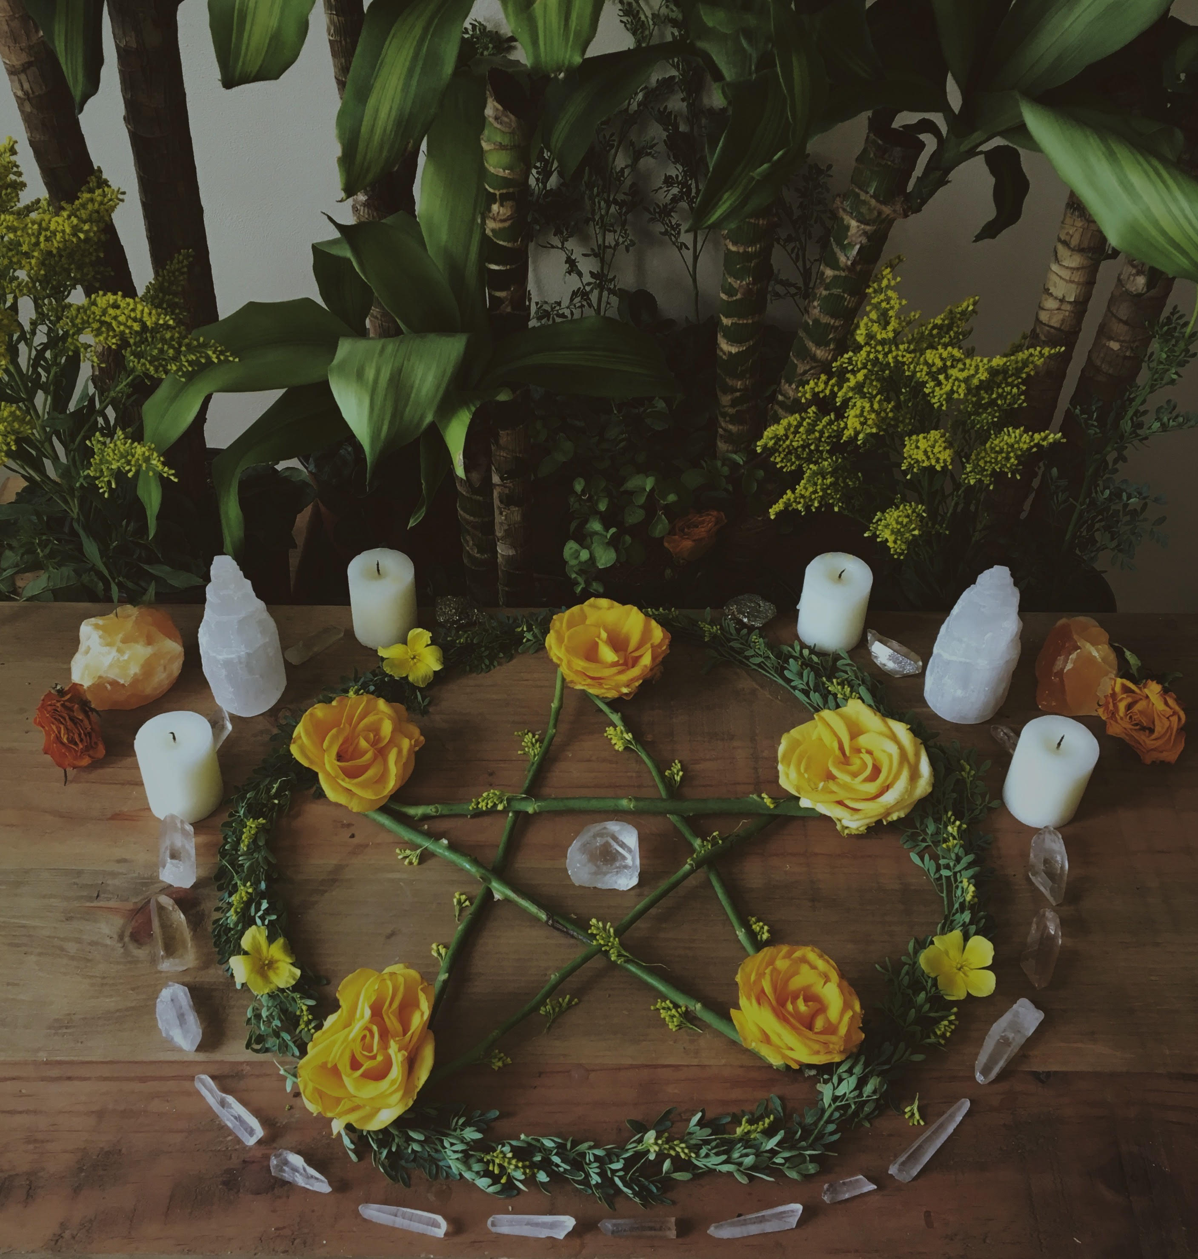
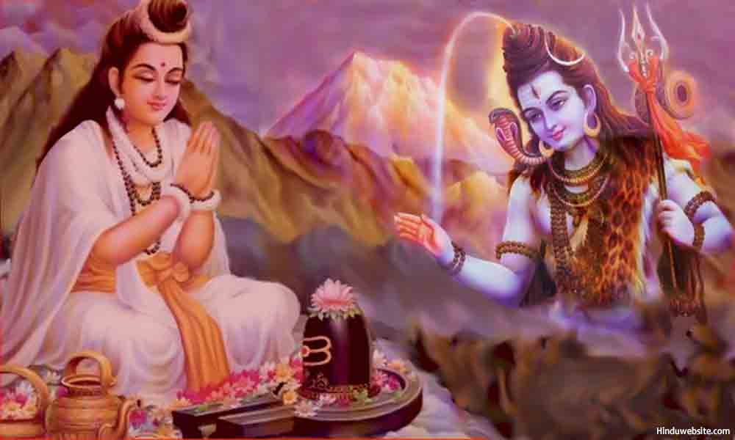
2 Symbolic expression in prayer and worship
Sticky Knowledge
Through the exploration of beliefs and practices, explain how symbolic actions in worship can communicate and express meaning beyond words.
Explore humility in prayer (e.g. genuflection, wudu, foot washing, silence and submission to Allah)
The power of light across religions and the importance of sharing food in Christian worship.
Assessment:
Why do Christians share food in worship?
How do people pray to God?
Explain the importance of light.

Slide 3
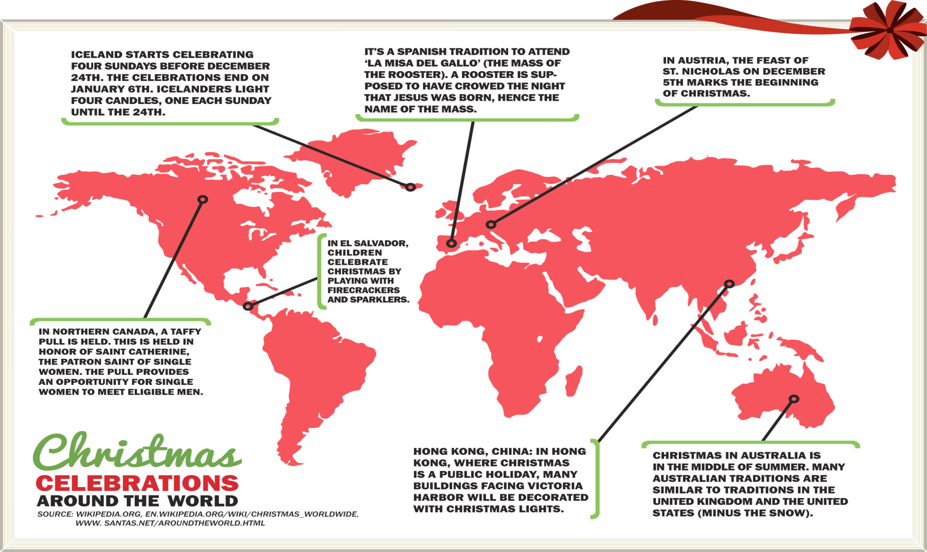
Assessment:
Can you think of how other countries celebrate Christmas?
What are the four main themes of Advent?
3 Advent and Christmas traditions around the world

Slide 4
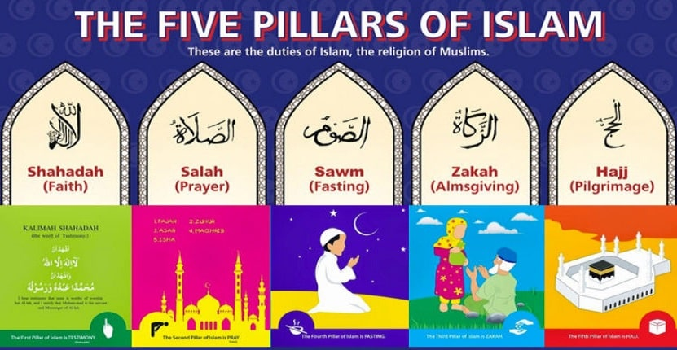
4 Belonging to a family, a community, challenges and religious leadership
Sticky Knowledge
Know what it means to belong to a faith community. Explore shared beliefs and develop imaginative and creative ways of expressing their own faith or belief commitments (e.g. Sikh Kalsa).
Look at the challenge of individual commitment, explore how the Five Pillars guide Muslims in their daily lives and question why some Muslims pray five times a day whilst others do not.
Look at the role and duties of historical and religious leadership (e.g. Jesus, Muhammad, Imam, Vicar) on followers and in their own lives.
Key words | Definitions
Shahada | A declaration of faith
Salah | Prayer, to be taken five times a day
Sawm | Sawm
Zakat | Giving to charity
Hajj | To complete the pilgrimage to Mecca at least once
Assessment:
What things would you choose in order to live a good life?
Why do some Muslims pray five times a day and others do not?

Slide 5
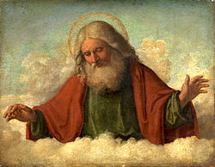
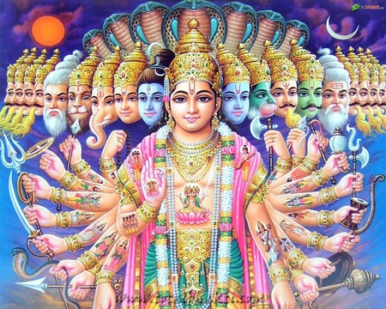
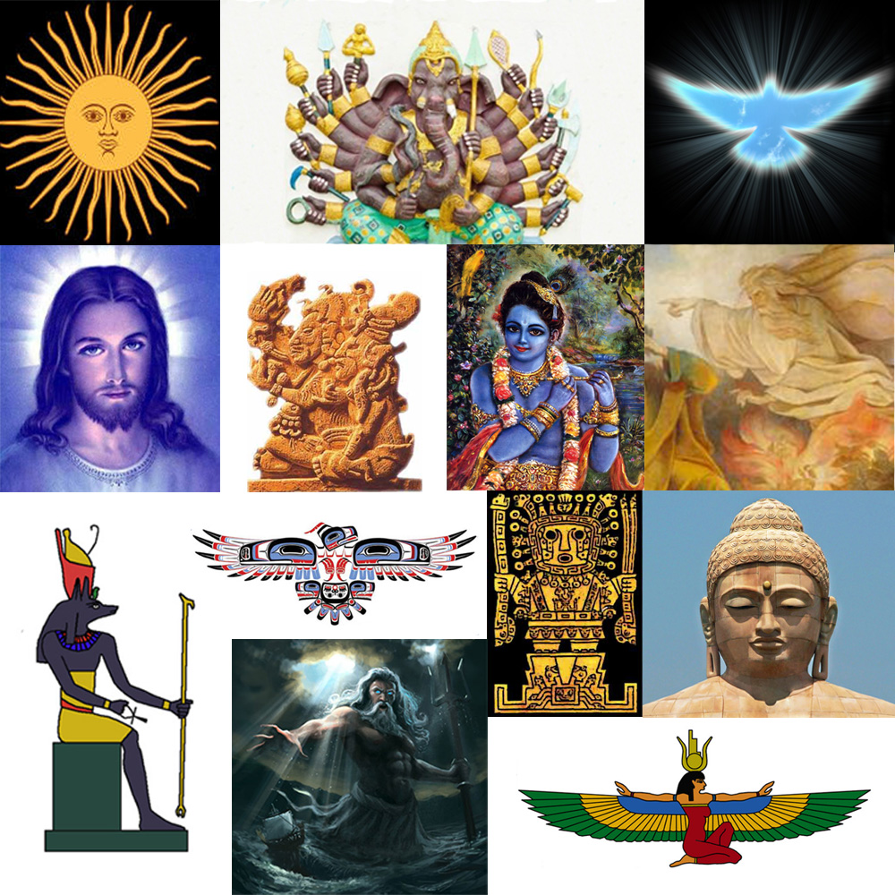
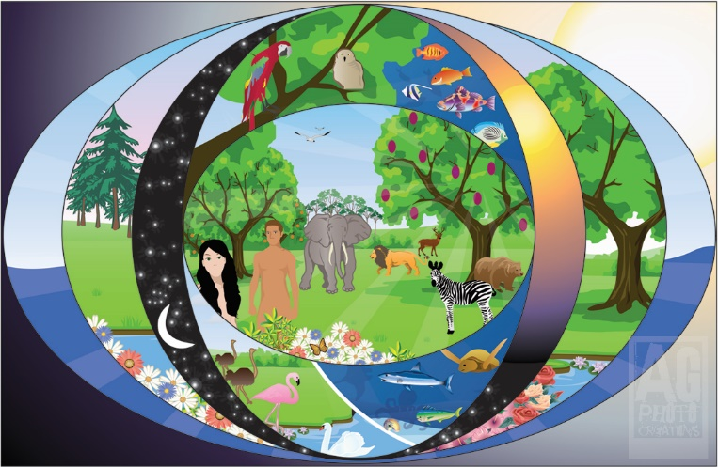
5 Different ideas about God and gods, creation and ultimate questions
Sticky Knowledge
Discuss challenging questions about meaning, purpose and truth and consider the different ideas about God
Learn some of the ways religion’s name and describe the attributes of God (e.g. 99 names of Allah and the Trinity).
Explore different stories about how the world began (Christianity and Islam), expressing creatively theirs and others ideas on creation, God and heaven though creative media.
Key Words
Creation
Genesis
Qur’an
Allah
Assessment:
Make a list of the similarities and differences between the
Christian and the Muslim creation story.
Why are there some questions about life to which we don’t
have the answers?
Can you draw a picture to show how you feel the world was created?
What do Christians learn from the Creation story?

Slide 6
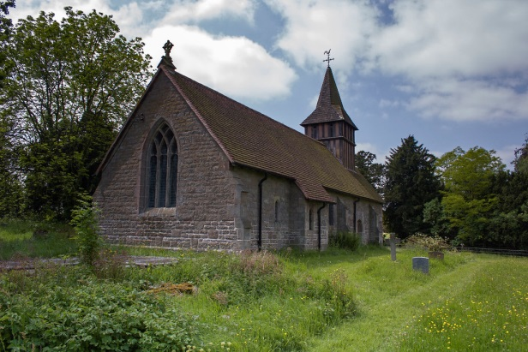
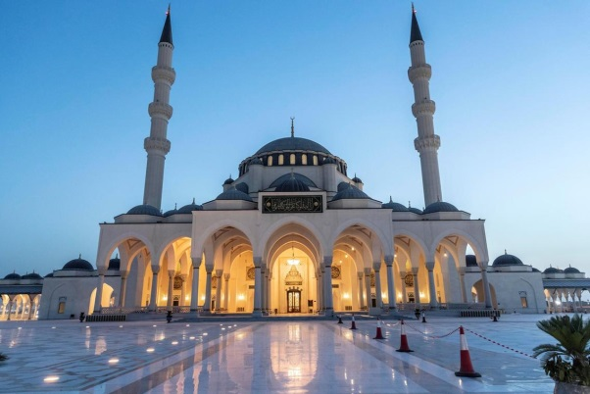
6 Communicating through sacred spaces and prayer
Sticky Knowledge
Investigate the role and special space for worship in a mosque and a church exploring meaning and significance for followers.
Examine how architecture and design may contribute to a worshippers experience and ask, who hears our prayers?
Learn about key prayers (e.g. the first Surah in the Qu’ran and The Lord’s Prayer) and how they might inspire a believer’s commitment.
Assessment:
What does worship mean to you?
Can you describe what it is like inside a church and a mosque?
What do worship have in common and what are the differences?
Key words
Worship
Church
Mosque

Slide 7
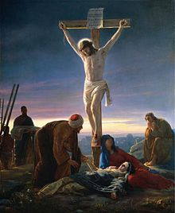
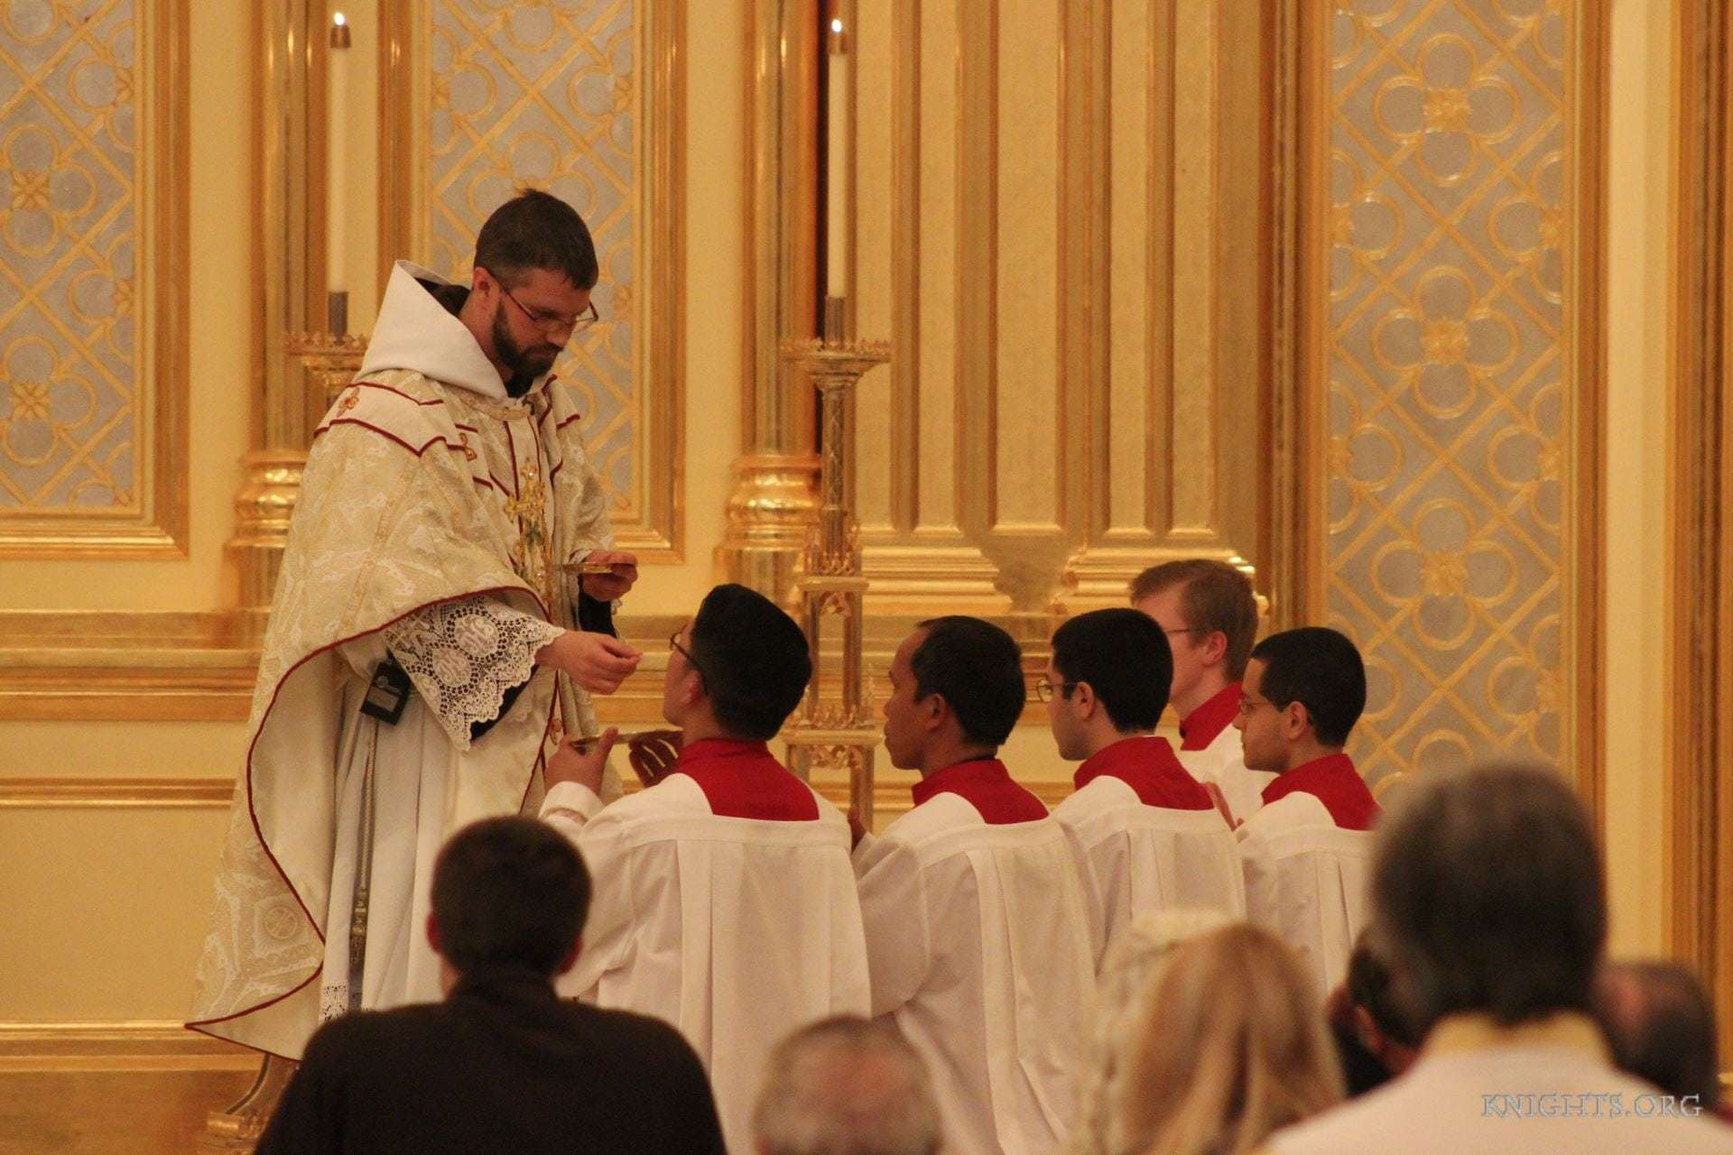
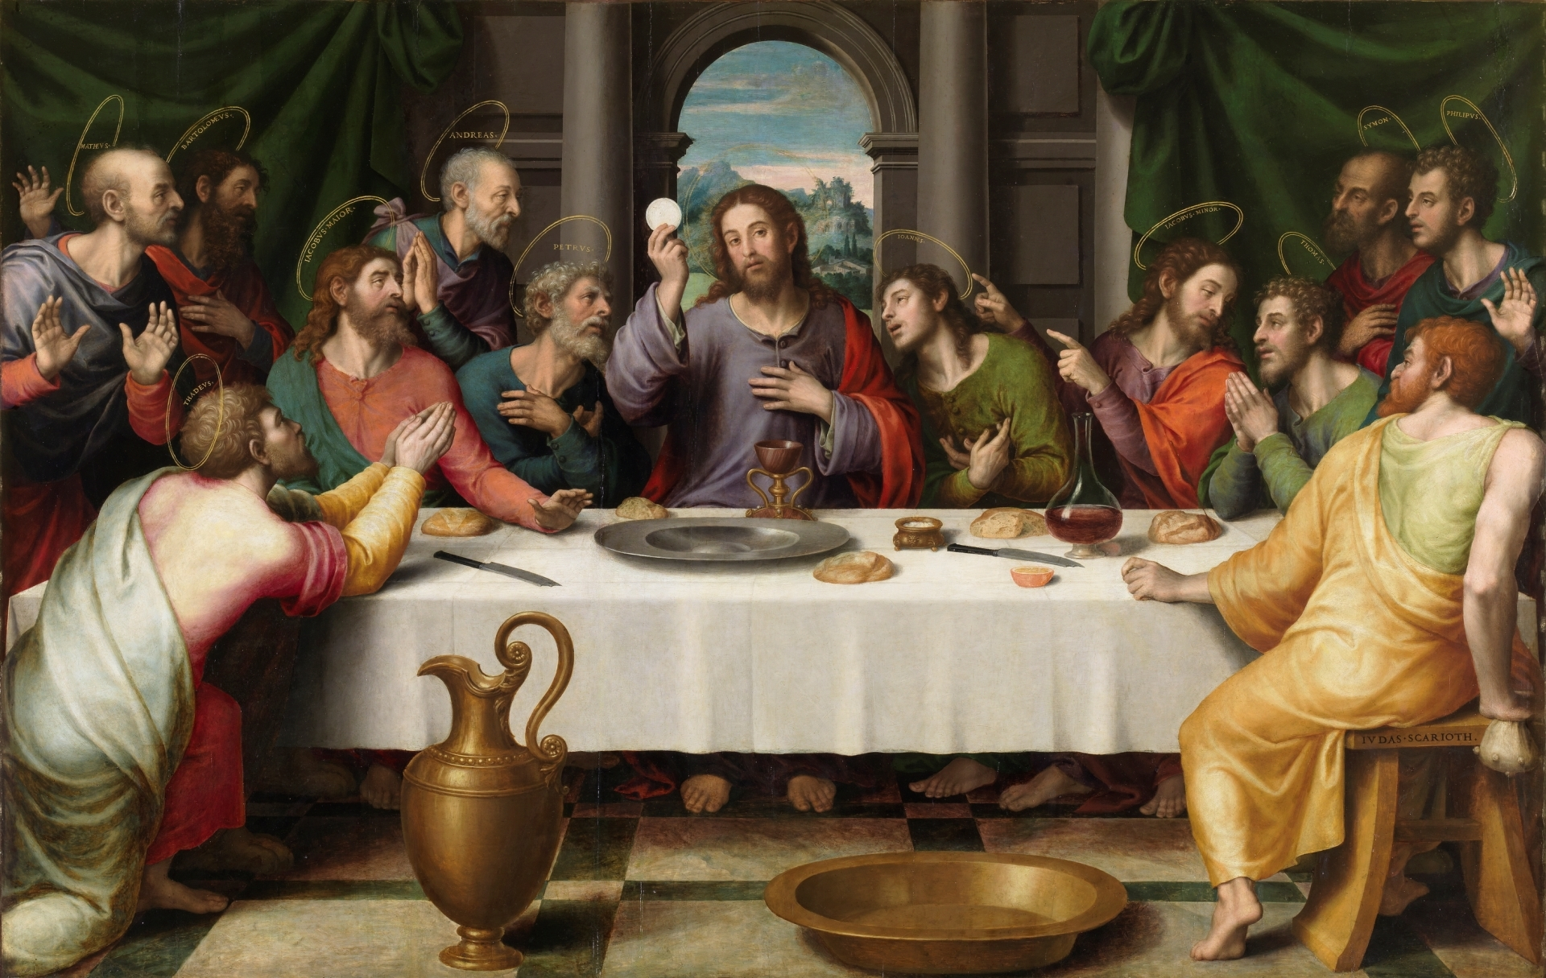
7 Exploring Lent, Holy Week and Salvation
Sticky Knowledge
Revisit the Easter story and learn about the Eucharist through visiting a local church or listening to a practising Christian.
Key words
Last Supper
Sacrament
Lent
Easter
Eucharist
Assessment:
What is happening in the pictures?
Why is bread and wine used in the
Eucharist?
Why do Christians call the day Jesus died Good Friday?

Slide 8
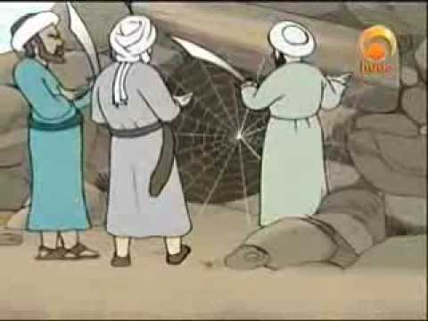
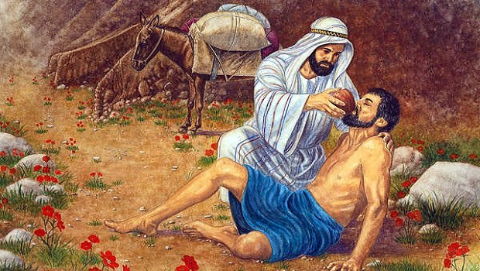
8 Sacred texts and stories, their guidance and impact
Sticky Knowledge
Enquire about what is wisdom, explore the power of faith stories and sacred writing from the Christian and Islamic traditions (e.g. The Good Samaritan, The story of Muhammad) and respond to the impact of these on religious followers.
Consider what is a sacred text, beliefs about its origin and how it should be treated (e.g. The Qur’an and The Bible).
Key words | Definitions
Samaritan | A helpful person
Levite | Member of Hebrew tribe
Prophet | Person believed to be speak on behalf of a God
Prophet Muhammad | The founder of Islam
Mecca | Holy city in Saudia Arabia thought to be the birthplace of Muhammad. The Hajj is an annual pilgrimage to Mecca
Assessment:
Who was Jesus?
Retell a faith story and explain its significance.
What is a sacred text and how do people show respect when using them in worship?

Slide 9
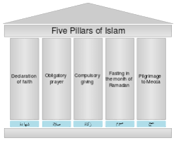
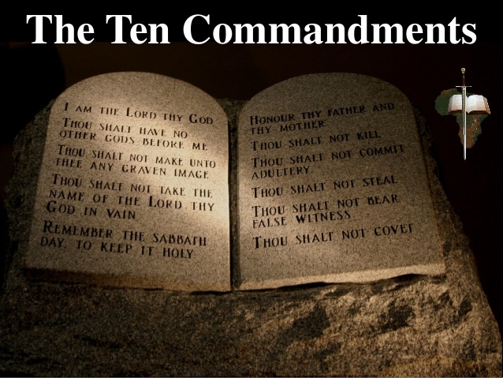
9 Taking responsibility for living together, values and respect
Sticky Knowledge
Consider our responsibility for the world and for each other and some religious and worldview responses e.g What kind of world did Jesus want?
Know what rules different communities follow about caring for the world/each other. Think about what is important and what is valued and compile a moral values charter.
Key words
Responsibility
Rules
Moral
Values
Assessment:
What kind of world did Jesus want?
What would you include in your own set of moral values?

Slide 10
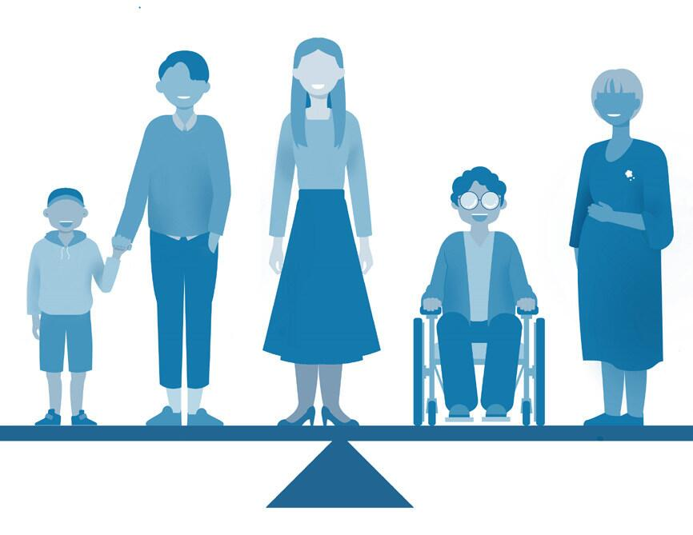

10 Right and wrong, just and fair
Sticky Knowledge
Learn about justice and fairness through the work of development charities (e.g. Christian Aid, Islamic Relief, Oxfam or their local religious charity group) and apply their own ideas on matters that are important.
Explore faith stories that illustrate justice and fairness and how to treat each other (e.g. Zacchaeus the Tax Collector and Widow’s Mite).
Reflect on who decides what is right and what is wrong.
Assessment:
Can you think of a faith story that shows fairness?
Does fairness mean that everyone gets the same?
How fair is the world?

