Slide 1

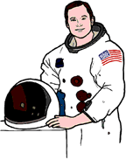
Live of Significant Individuals –
Neil Armstrong/ Christopher Columbus
Sticky knowledge
Neil Armstrong is a famous American astronaut. (1930-2012) | Christopher Columbus was an Italian explorer. (1451 – 1506)
Neil Armstrong is most famous for being the first man to walk on the moon. | Christopher Columbus is famous for being the first European to discover ‘the Americas’
Similarities and difference between Neil Armstrong and Christopher Columbus.
Key Questions
Explain why Neil Armstrong is famous.
Explain why Christopher Columbus is famous.
How are these individuals similar? (courage, determination, successful)
How are these individuals different? (lived in different times, sailing / space)
What makes them great explorers?
Key words
Famous, space, astronaut, engineer, Apollo, navigator, mission, explorer, voyage, compare, new world, similarities, differences. timeline

Slide 2
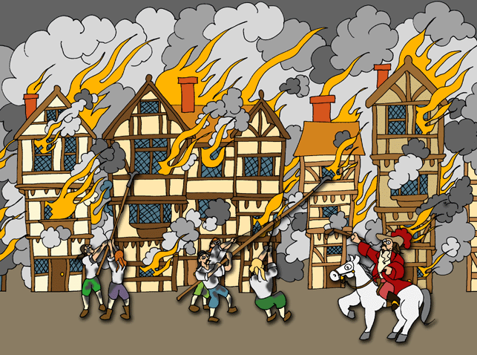
Live of significant people–
Great Fire of London Knowledge Mat
Sticky knowledge
The Great Fire of London was in 1666, long before their Grandparents were even born | To fight fires during this time, people would have used leather buckets, metal hooks and water squirts
The fire began in a bakery in Pudding Lane and lasted 4 days. | We know what happened during the fire because people back then wrote about it in letters and newspapers and art – for instance, Samuel Pepys wrote about it in his diary.
Understand why the the fire was so big – 10 month drought, houses built from wood – very close together. | What was the impact of the fire? (homelessness, people never returned, houses made to be further apart and made from stone, an organised Fire Brigade was established, people began to insure their houses, city redesigned (Sir Christopher Wren).
Key Questions
When did the Fire of London happen?
Where did the fire begin?
Why did the fire spread?
How did they try and stop the fire?
How do we know what happened as it was so long ago?
Why is Samuel Pepys an important person?
Did the Great Fire of London have any benefits for society?
Key words
Pudding Lane, water squirts, leather buckets, metal hooks, human chain, Samuel Pepys, eyewitness crowding, drought, flammable, population, migration
BLM link - Explore the ethnic diversity of London now and then(immigrants - (The Great Fire of London was blamed on ‘popish’ foreigners, as the Monument once stated.’)

Slide 3
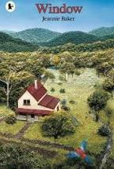
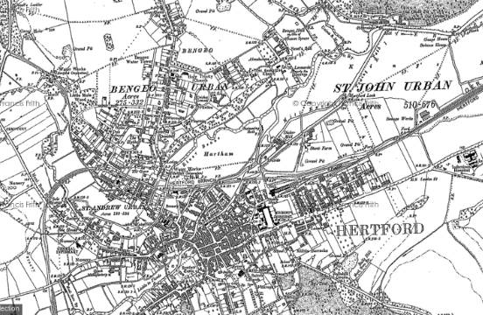
Local History – Bengeo
Sticky knowledge
The local area has changed in the past 100 years . | Farmland has been built on
More houses/ roads/ have been built. | Sequence how Hertford castle has change. A fort, prison, house, school ,office
Some places are protected from change (Hertford castle/ green belt) and cannot be built on.
Key Questions
What has changed over the past 100 years in Bengeo?
Why do you think this has changed?
Explain why some places are protected form change?
Key words
Compare, changes, similarities,
sequences
buildings
houses
field/ farmland
protected , green belt, quarry

