Slide 1
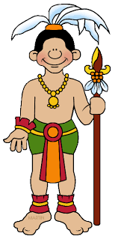
Mayan Civilization Knowledge Mat
Sticky knowledge
The Mayans were expert mathematicians and astronomers. They used this expertise to make calendars. | At the top of Mayan society was the King and Royal family who were believed to be closely linked to the Gods. An educated elite of scribes, priests and nobles formed the ruling class. They occupied the finest buildings in the city.
Although the Mayans had metal working skills, metal ores scarce. Mayans used stone tools to carve limestone that they used for their buildings. | Mayan society was formed of a number of city states each with their own ruler.
Mayan religion was extremely bloodthirsty, demanding human sacrifices and blood letting rituals. They believed in afterlife as well as those killed in war/ women in childbirth went to the place in the ‘misty sky’ | To understand how the Mayans were a very advanced society and the impact they had – Mayan culture was well established by 1000 BCE and it lasted until 1697.
Key Questions
Explain some key features of Mayan society (religion, ruling, inventions).
How does Mayan Civilization compare to other civilisations at the same period of time?
What impact did the Mayans have? What was their legacy?
Key words
Glyphs, codices, Chichen Itza, Cacoa, Ahau/Ahaw, Batab, Itzamna,, Kukulcan, calendars, metal working skills, religion, Royal family, scribes, city states, timeline
Diversity – history of ancient civilisation in Mexico

Slide 2
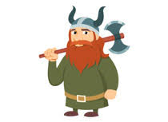
The Vikings Struggle for the Kingdom of
England Knowledge Mat
Sticky knowledge
The Vikings originated from Scandinavia (Denmark, Norway and Sweden). | The lands that the Vikings occupied were known as Danelaw. The most important Viking British city was York or Jorvik (as it was known to the Vikings.)
Viking warriors were known to be vicious. However, not all Vikings were warriors. Many came in peace and become farmers. | Longships were designed to sail in both deep and shallow water so they could get close to shore and not be easily seen
Vikings were pagan and often raided monasteries, looting gold. | Name significant leaders of the different areas - Alfred the Great
Key Questions
Where did the Vikings originate? Locate this on map.
Why did the Vikings often win battles with the Anglo Saxons?
Did Alfred the great deserve his title?
What impact did the Vikings have on England?
Key words
Raids, longhouse, Danelaw, Norse, longship, monasteries, Jorvik, Scandinavia, Odin, berserkers, vicious, misconception, Alfred the Great

