Slide 1
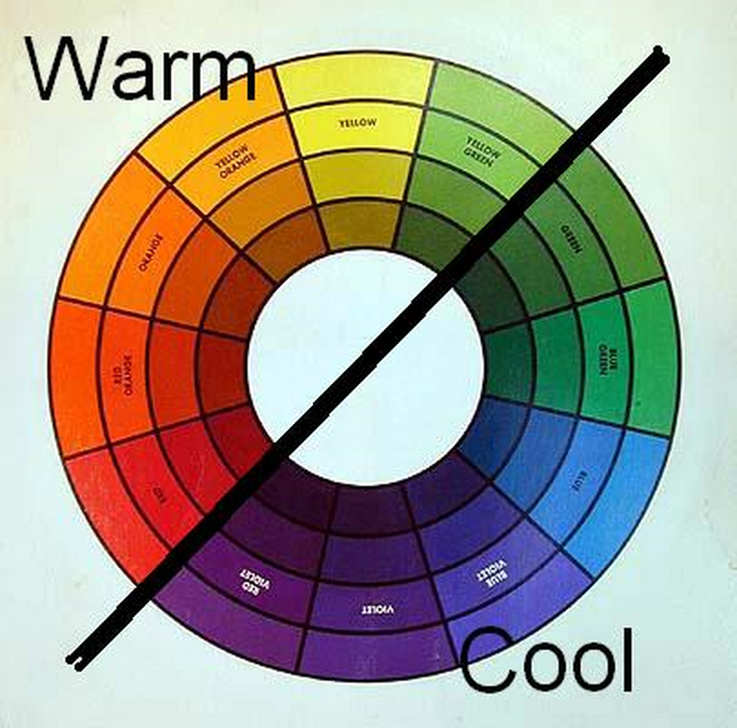
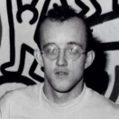

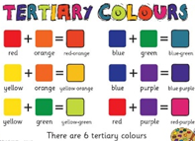
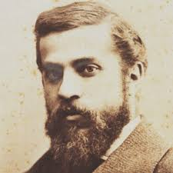

Year 3 Colour/Painting Knowledge Mat
Sticky knowledge | Associated Famous Artist/s
To know that the primary colours are:- red, yellow and blue. Know that secondary colours can be made by mixing red + yellow = orange, blue + yellow = green blue + red = purple Know how to mix tertiary colours. Know that there are complimentary colours and warm and cold colours | Keith Harring, Gaudi
Assessment
Can you use a range of colours in your work?
Vocabulary | Definition
Primary colours | These are colours that cannot be created by mixing other colours. They are colours in their own right. These are red, yellow and blue.
Secondary colours | These colours are made by mixing each primary colour with one other primary colour. These are orange, green and purple.
Tertiary colours | Tertiary colours are combinations of primary and secondary colours. There are six tertiary colours; red-orange, yellow-orange, yellow-green,, blue-green, blue-violet, and red-violet.
Complimentary colours | Complimentary colours are the opposite hues (colour or shade) on the colour wheel.

Slide 2
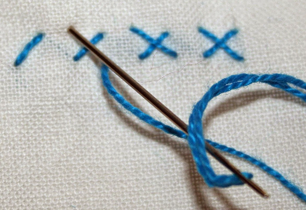
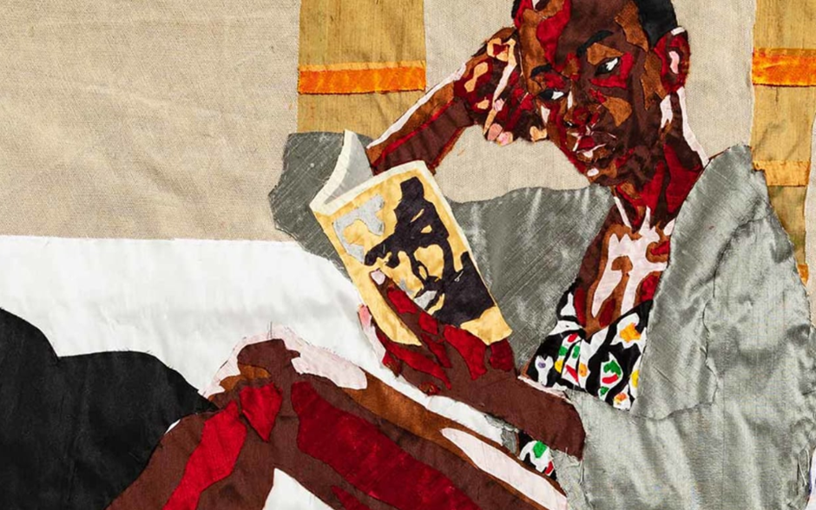

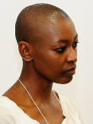

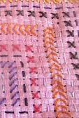

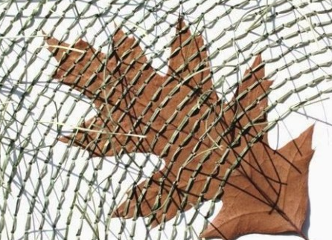
Year 3 Textiles/Sewing Knowledge Mat
Sticky knowledge | Associated Famous Artist/s
To revisit knowledge of running stitch. To know how to use cross stitch | Billie Zangewa
Assessment Can you use running and cross stitch in your design?
Kazuhito Takadoi
Vocabulary | Definition
Running stitch | To create a running stitch, the needle is passed in and out of the fabric.
Cross stitch | Stitches are sewn in an X-shape.
Key Words: | Fabric, textiles, sewing, running stitch, cross stitch, thread, needle, eye of the needle

Slide 3
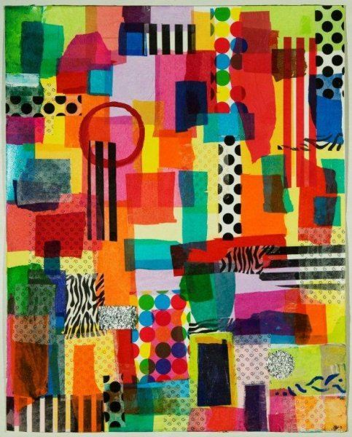
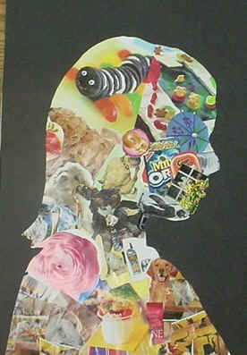
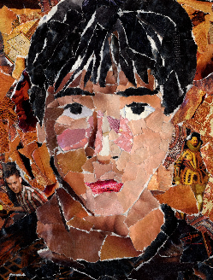
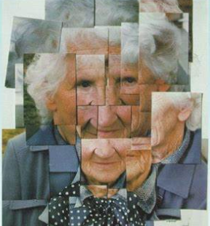
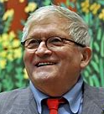
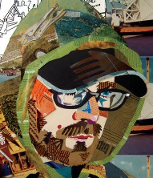
Year 3 Collage Knowledge Mat
Sticky knowledge | Associated Famous Artist/s
To know that collages can be made from a variety of media and that materials are stuck down and overlapped | David Hockney (photomontage – collage from photographs)
Assessment
In your art work, can you select colours and materials and overlap images?
Vocabulary | Definition
Collage | Collage refers to both the actual procedure of cutting and pasting. Collage comes from the French word meaning ’to glue’.
Overlap | The arrangement and sticking of objects with one object slightly on top of the other.
Key Words: | Collage, overlap, arranging, photomontage

Slide 4
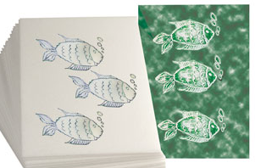
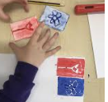
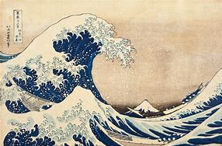
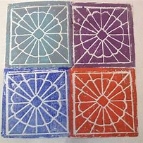
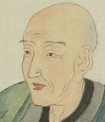
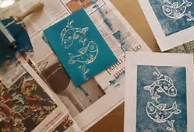
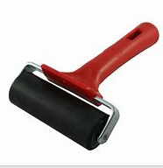
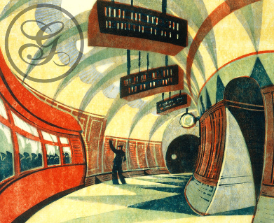
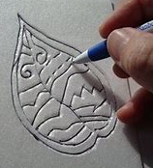
Year 3 Printing Knowledge Mat
Sticky knowledge | Associated Famous Artist/s
Know that using relief printing is a technique whereby what you ‘etch’ out of your tile, won’t be printed Know that images can be repeated and/or rotated | Hokusai Cyril Edward Power
Assessment
Can you etch out an image on your polystyrene tile and print to create a design?
Vocabulary | Definition
Etched | To cut into the surface of something to form lines.
Repeat printed images | An image that is printed again and again and again
Rotate printed images | An image that is turned
Key Words: | Roller, polystyrene tiles, printing inks, etch, repeated image

Slide 5
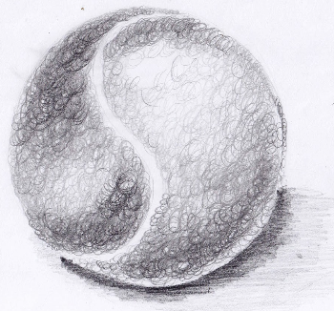
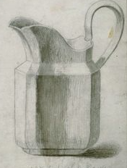
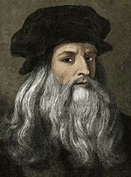
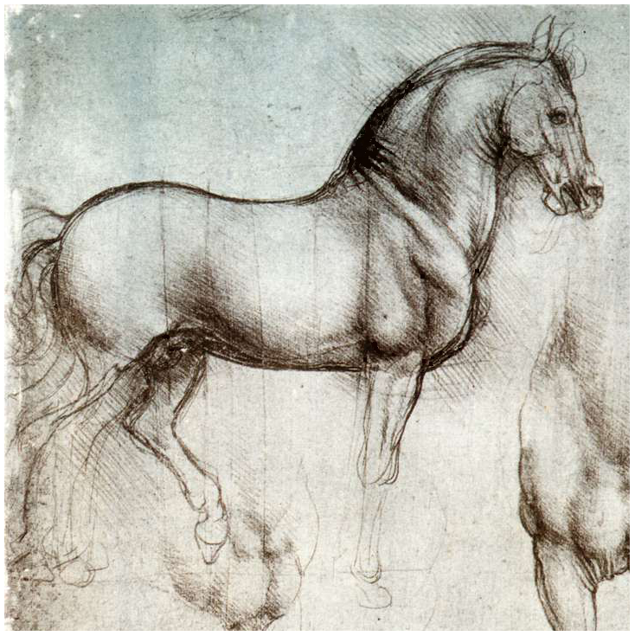

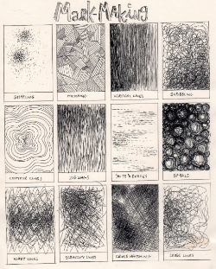
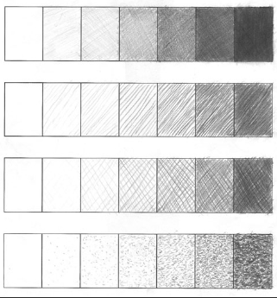

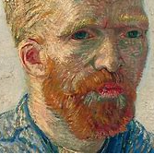
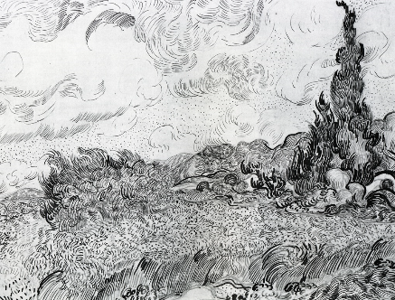

Year 3 Shading Knowledge Mat
Assessment
Can you spot the different shades used on the jug?
Can you use different shades in your work?
Sticky knowledge | Associated Famous Artist/s
Know how to use different grades of pencil to shade and show tones and textures Know the different mark making techniques. Know that HB, 2B and 6B give different shades | Leonardo De Vinci Vincent Van Gogh
Vocabulary | Definition
Shading | Shading is a technique used in art to represent light and shade by varying the colour and intensity of the medium being used. This helps create the illusion of depth and shape in an otherwise flat work.
Pencil grades | A pencil’s grade is dependant on the blend and ratio of two products: the more clay there is, the harder and lighter a pencil will be; the more graphite there is, the darker and softer it will be.
Tone and Texture | Texture is used to describe the way a three-dimensional work actually feels when touched. Tone is the lightness or darkness of a colour.
Key Words: | shading, pencil grades, mark making, tone, texture, light, dark

Slide 6
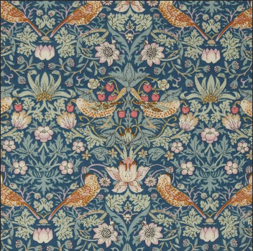
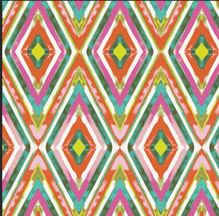
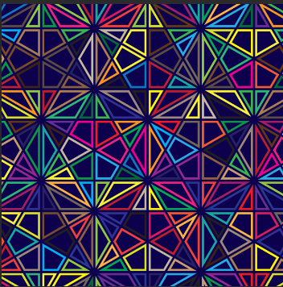
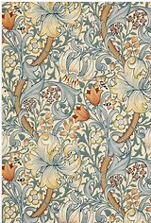
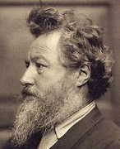
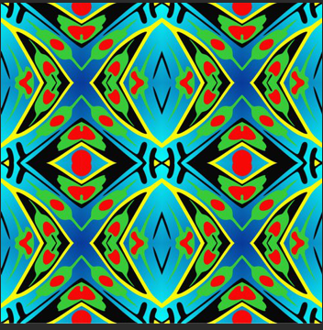
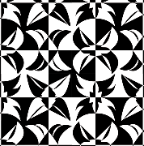
Year 3 Digital Art Knowledge Mat
Sticky knowledge | Associated Famous Artist/s
Know that art can be created digitally and that technology can be used to recreate an artistic style. Know that shapes can be created on the computer considering shape, colour and design. | William Morris (use of repeated patterns)
Can you spot the repeated pattern in William Morris’ art work?
Assessment
Can you plan and then create a repeated design on the computer?
Vocabulary | Definition
Computer art | Computer art is one where computers play a role in production of the artwork.
Key words | Repeat, design, turn, flip, rotate, shapes, geometric, colours

