Slide 1

Year 6
PSHE

Slide 2
PSHE Units
Unit 1- Being Me in My World
Unit 2- Celebrating Differences
Unit 3- Dreams & Goals
Unit 4- Healthy Me
Unit 5- Changing Me
Unit 6- Transition

Slide 3
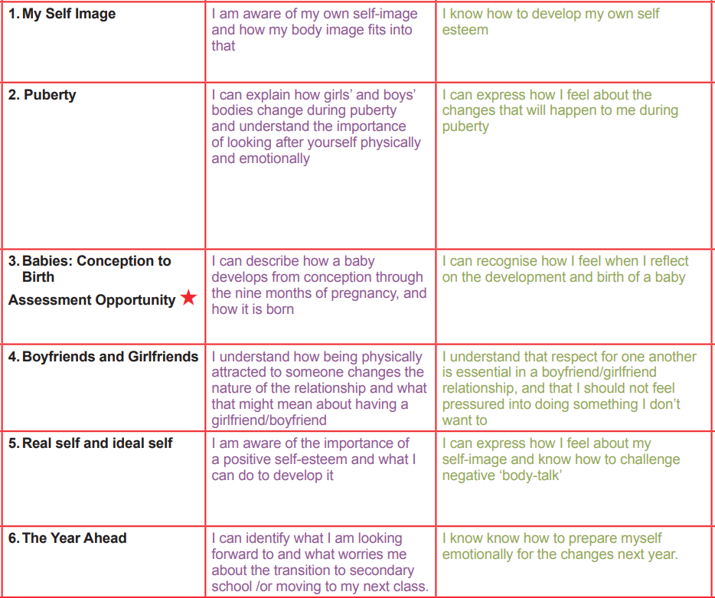
Changing Me

Slide 4
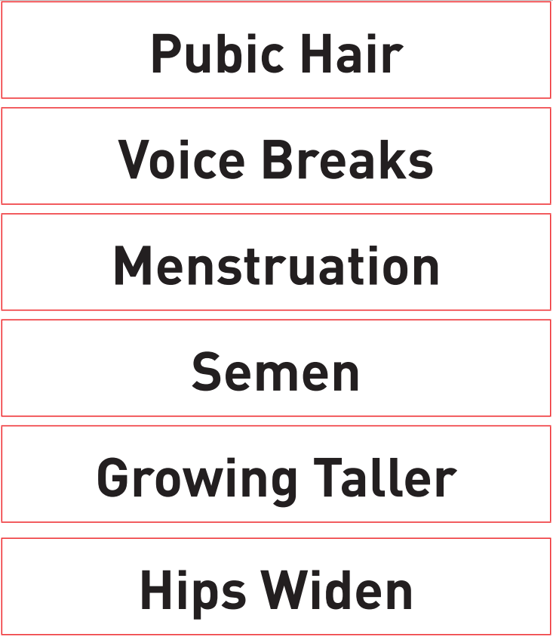
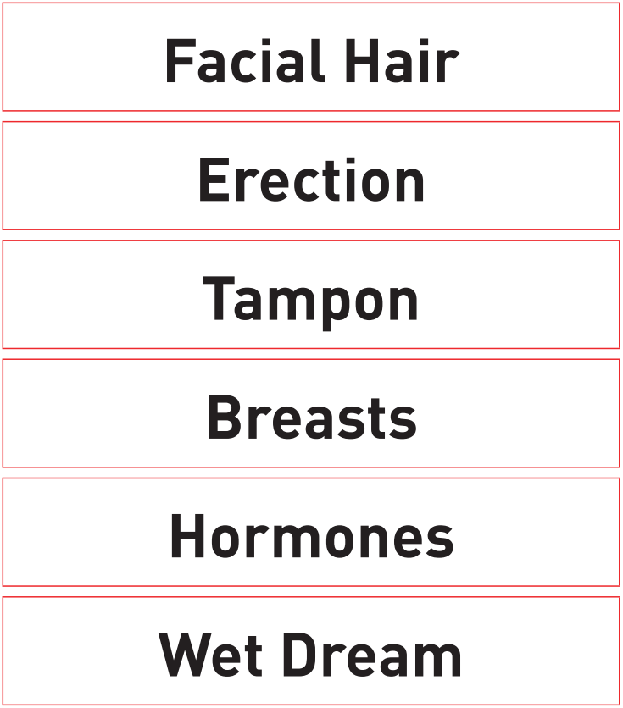
Children will be exposed to and learn about the following terminology:

Slide 5
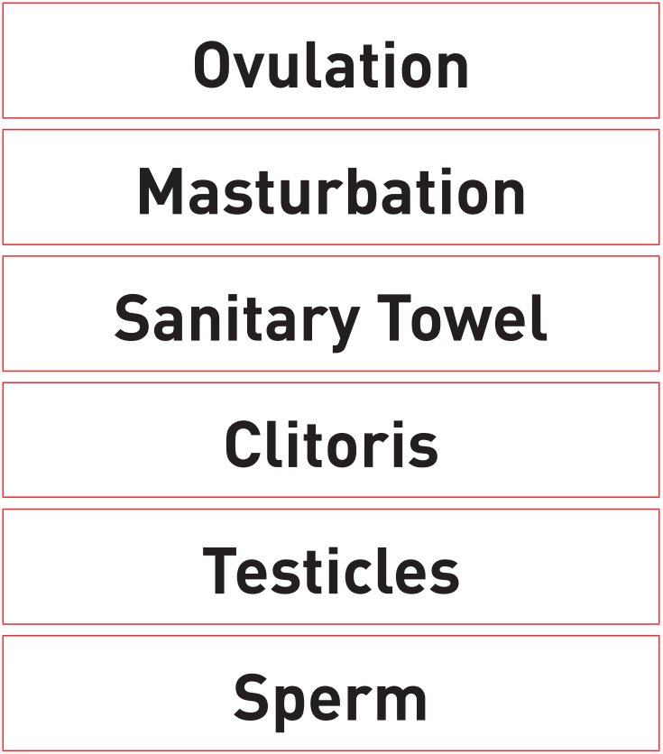
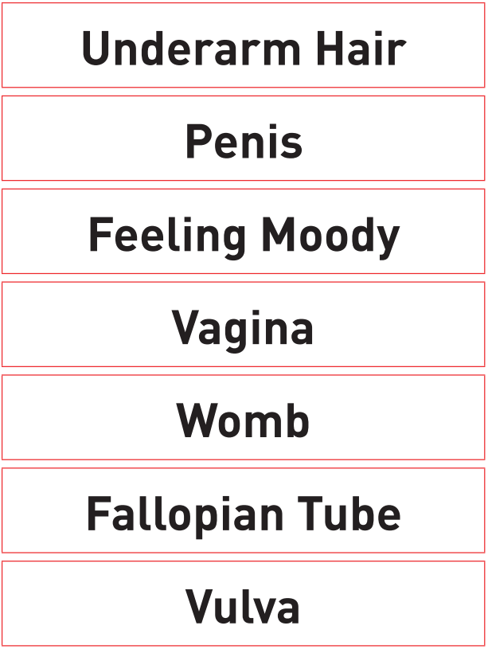
Children will be exposed to and learn about the following terminology:

Slide 6
Important Information
Boys and girls will be in the classroom at the same time and will be learning about the opposite sex too.
As you can imagine, there are always plenty of questions. Sometimes the children feel confident enough to ask in the lessons whilst others prefer not to.
If a child would prefer there question to remain anonymous, then they can write it on paper and place it in a secure box. Their question will then be addressed at the end of the lesson or the beginning of the next lesson.
The teachers will determine if questions are age appropriate and therefore whether they will be answered or not.

Slide 7
Links
If you would like further information, please feel free to follow the links to the school’s website.
https://www.bengeo.herts.sch.uk/attachments/download.asp?file=381&type=pdf
https://www.bengeo.herts.sch.uk/attachments/download.asp?file=235&type=pdf

