Slide 1
Year 5
PSHE

Slide 2
Important Information for Parents
Although all of the PSHE units are equally important for your child’s personal, social and health development, the Changing Me unit includes knowledge which many children will want to discuss further with their peers, teachers and parents/carers.
You know your child best. Please look through the sequence of learning and consider whether your child will benefit from some preparation or from further explanation/discussion at home. It may be that you are simply available for any questions that may come your way!
Please let your child’s teacher(s) know if you have any questions or concerns.

Slide 3
PSHE Units
Unit 1- Being Me in My World
Unit 2- Celebrating Differences
Unit 3- Dreams & Goals
Unit 4- Healthy Me
Unit 5- Relationships
Unit 6- Changing Me

Slide 4
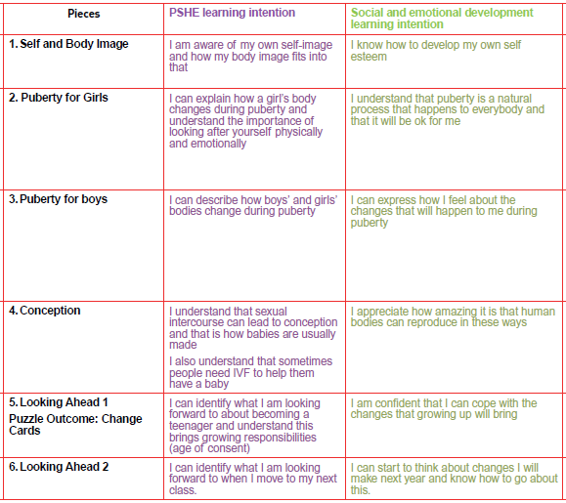
Changing Me

Slide 5
Children will be exposed to and learn about the following terminology:
Puberty | Vagina | Conception
Menstruation | Oestrogen | Making love
Periods | Vulva | Sexual intercourse
Sanitary towels | Womb/Uterus | Fallopian tube
Sanitary pads | Sperm | Fertilisation
Tampons | Semen | Pregnancy
Ovary/ Ovaries | Testicles/Testes | Embryo
Erection | Ejaculation | Umbilical cord
Wet dream | Larynx | Contraception
Facial hair | Growth spurt | Fertility treatment (IVF)
Hormones | Relationships

Slide 6
Important Information
Boys and girls will be in the classroom at the same time and will be learning about the opposite sex too.
As you can imagine, there are always plenty of questions. Sometimes the children feel confident enough to ask in the lessons whilst others prefer not to.
If a child would prefer their question to remain anonymous, then they can write it on paper and place it in a secure box. Their question will then be addressed at the end of the lesson or the beginning of the next lesson.
The teachers will determine if questions are age appropriate and therefore whether they will be answered or not.

Slide 7
Links
If you would like further information, please feel free to follow the links to the school’s website.
https://www.bengeo.herts.sch.uk/attachments/download.asp?file=381&type=pdf
https://www.bengeo.herts.sch.uk/attachments/download.asp?file=235&type=pdf

