Slide 1

Welcome to Year 3
2024
Notes:
1

Slide 2
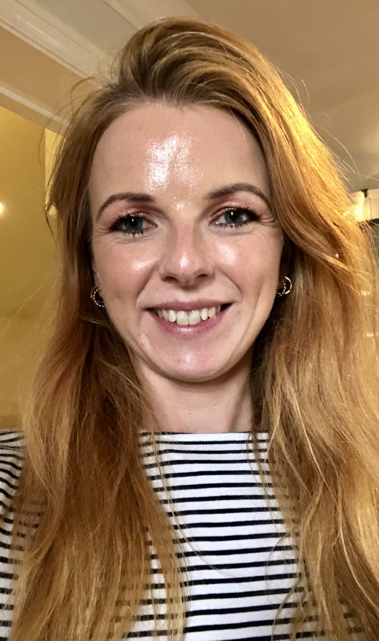
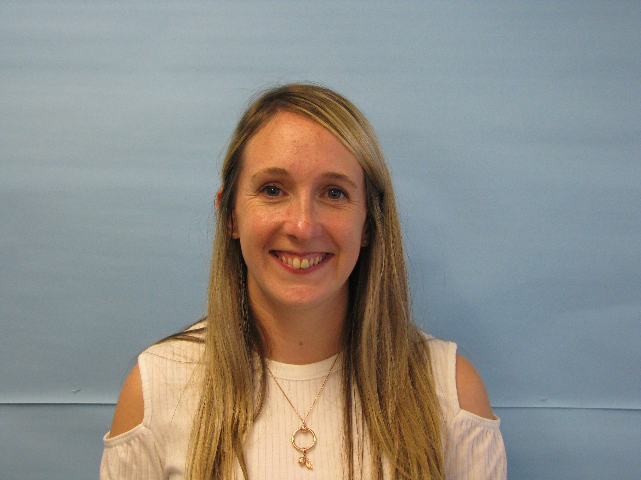
Year 3 staff
Oak Class Teachers
Mrs Glover (M/T)
& Mrs Dove (W/Th/F)
Learning support
Mrs Betts
Mrs Reaney
Mrs Manlove
Monkey Puzzle Class Teacher
Miss Dymock
Notes:
2

Slide 3
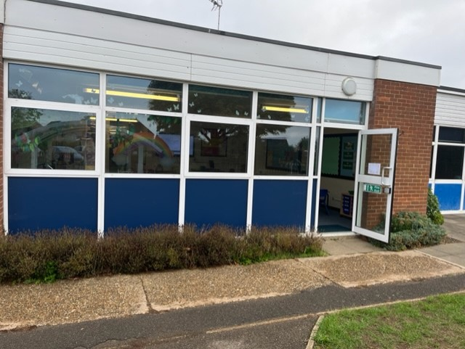
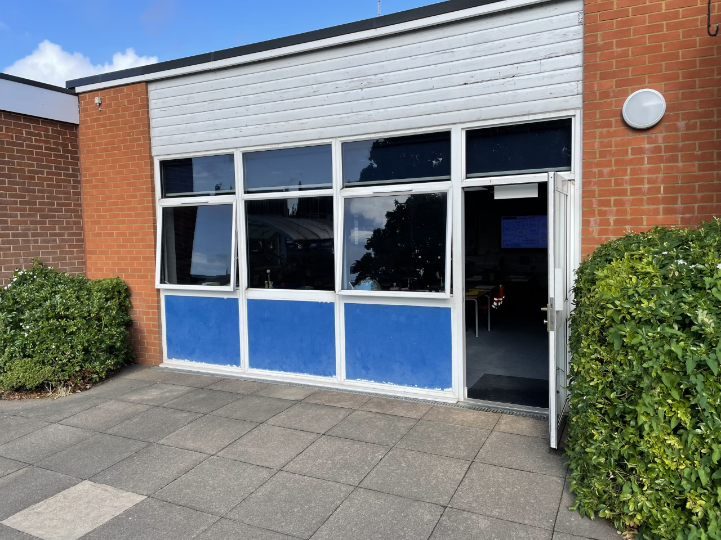
Where we are
Entrance to Monkey Puzzle
Entrance to Oak

Slide 4
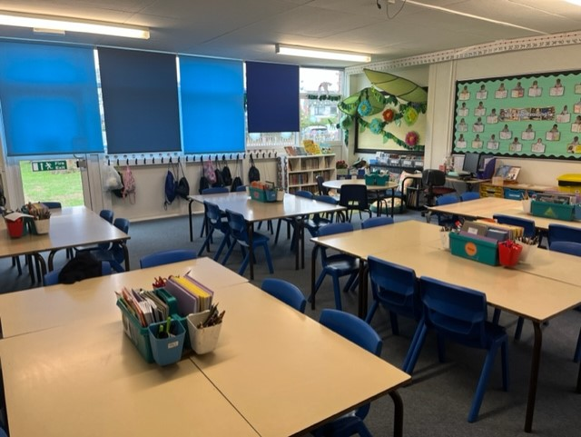
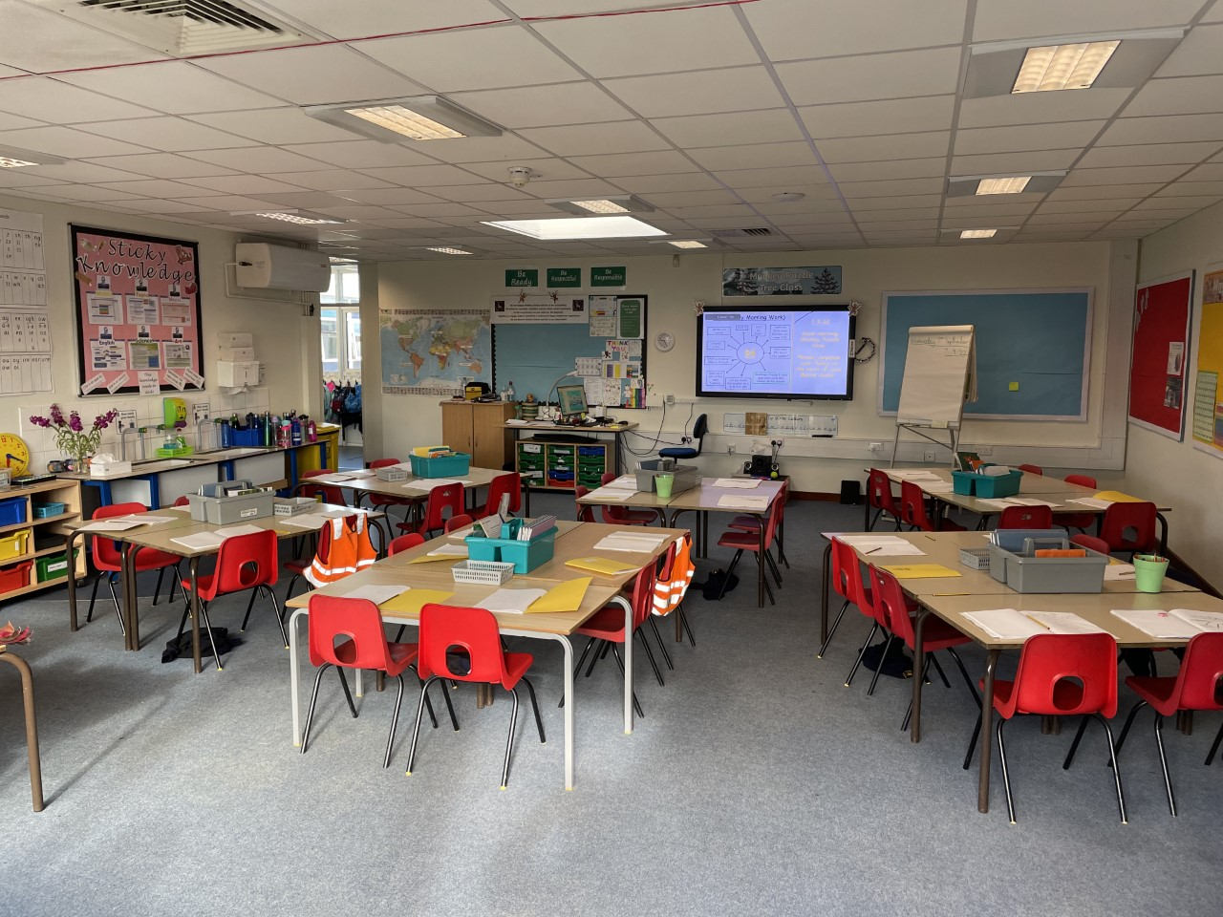
Classrooms
Oak
Monkey Puzzle

Slide 5
Year 3 learning this year
Notes:
5

Slide 6
KS2 expectations
Ready Responsible Respectful
Independence
Responsibility
Confidence
Resilience
Attitudes to learning
Positive behaviour

Slide 7
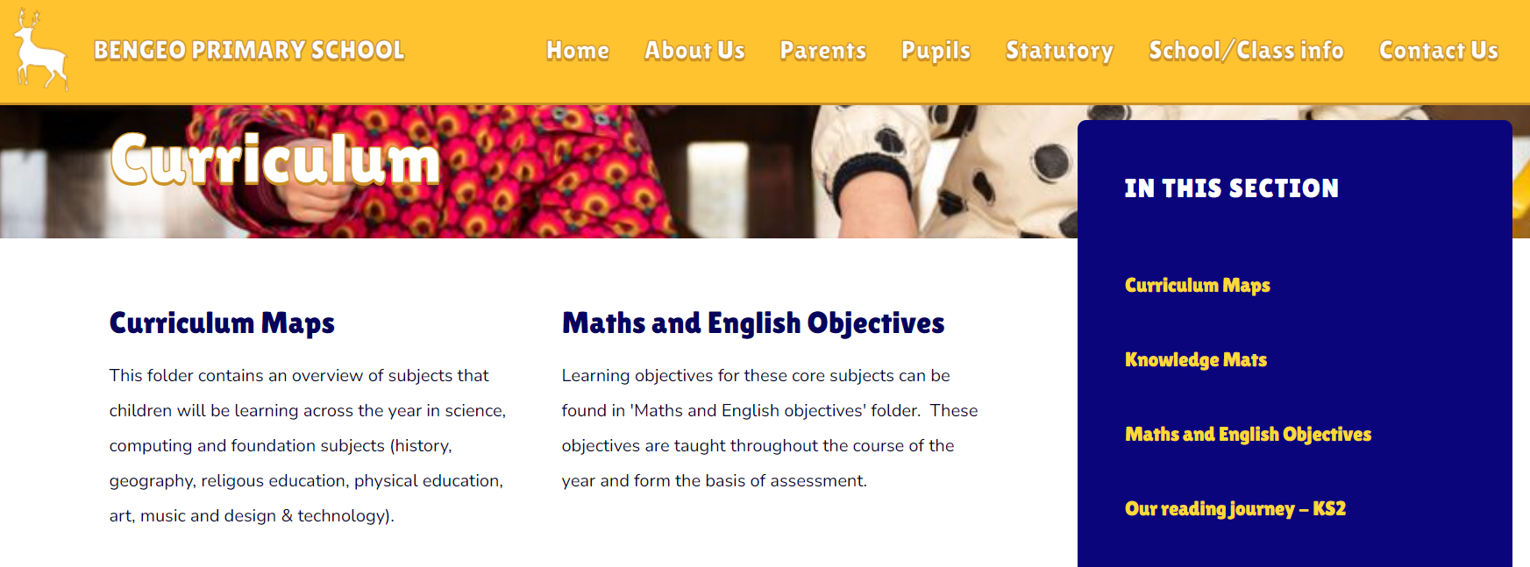
Curriculum map
The curriculum map for Year 3 is on the school website.
For some children, it is useful to talk through what is coming, particularly in terms of vocabulary.
(Sometimes we make changes to the curriculum – we will let you know if we do)
Please do not read the core texts ahead of time as an important part of children’s learning is the ability to predict.

Slide 8

Spelling
There is more emphasis on spelling and grammar in the current curriculum.
We follow a spelling programme across KS2 - ‘Read Write Inc. - which embraces knowledge of spelling conventions, patterns and rules. It will follow a revise, teach, practise and apply teaching sequence. Further recall and rehearsal practice will help commit these spellings to memory.
Please encourage your children to sound out words one sound at a time as this provides strategies to support them with spellings.
Some children may be taking part in an additional spelling programme designed to support them in securing their sounds and spelling patterns.
The Y3/Y4 statutory spelling list is also on the website.

Slide 9

Times Tables
By the end of Year 3, children should be confident with their 2, 5 and 10 times tables (from Year 2) and 3, 4 and 8 times tables.
Times table practice is included as part of our weekly home learning slide. Please practise with your child regularly.

Slide 10


Reading
To help with enjoyment and comprehension, please spend time talking about vocabulary, characters, plot, style, context, the author’s style and intention, eg. to create a picture with words.
While it is lovely for children to find a genre or author that they enjoy, it is important that they read a wide range of genres and books by both significant authors and those less well-known.
Bengeo Primary School places a lot of importance on reading, both at school and at home.
Children are given many opportunities for reading and talking about books at school.
We expect them to read at home and out loud to an adult as well as discussing the text.
At school, we teach reading and comprehension skills.
We spend time talking about vocabulary, characters, plot, style, context, etc.

Slide 11

Home Learning
Homework will be set on Google Classroom each Friday and tested the following Friday.
Daily reading
Please listen to your child read daily, discuss the text and record this in the reading record. We will look at these on a weekly basis.
Spellings
Each week children will be taught spelling words based
around a spelling rule. Please practice spellings for the test on Fridays.
Maths
Times Table Rockstars

Slide 12
PE
PE kit: navy blue shorts, white round-necked T-shirt, trainers for outdoor PE, navy blue tracksuit bottoms in cold weather. Bare feet for gymnastics/dance.
PE kit should be left at school in a bag and should be named. It will be sent home regularly for washing.
No jewellery or earrings should be worn. If children are unable to take earrings out they will have to cover their earrings with tape supplied from home.
Our PE days are Tuesday (outdoors) and Fridays (indoors) this half term. We will inform you if this changes on Google Classroom.

Slide 13

Break time snacks
Children no longer receive fruit in Year 3 so can bring their own snack from home such as fresh fruit or vegetables.
As part of our Healthy School’s status, we are trying to promote healthy snacks at break time.
We are a nut and sesame free
school.
Children need a water bottle every day.

Slide 14

Wet weather
Please ensure children bring in coats every day as they will be expected to go out at playtimes.
We also use our outdoor learning area regularly.

Slide 15

Attendance and punctuality
Please ensure children are supervised before entering the classroom, not running around and playing on equipment.
Please try and aim for a prompt start as learning starts immediately on entry into the classrooms.
Doors open at 8:45am and again at 3.20pm for collection.

Slide 16

Communication
It is important for teachers to greet the children in the morning and therefore there will not be time for a chat with parents or carers other than a quick hello or message about picking up.
It is easier to talk after school, except on days when we have meetings.
If you do have an important question or query, please do email the office and they will ensure that we receive your messages.
Google Classroom will be used for homework.
All children have been invited on to their new Google Classroom so please accept the invitations.

Slide 17
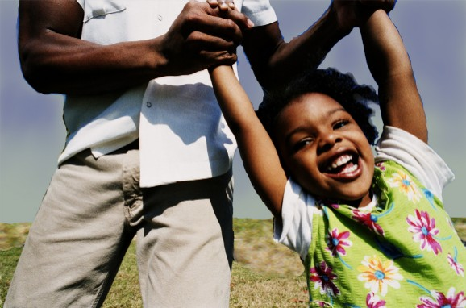

Together we are stronger
Our partnership is essential to your child's education.
We value your help and support.
If you have any questions or comments, please email the school.

